Slide 1
Class Diagram
CONT.

Slide 2
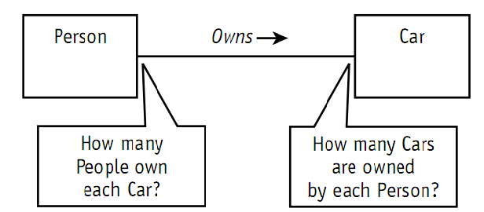
Association multiplicity
The UML allows you to handle some other important questions about associations: “How many Cars may a Person own?” “How many can they rent?” “How many people can drive a given Car?”
Associations define the rules for how objects in each class may be related. So how do you specify exactly how many objects may participate in the relationship?

Slide 3
Association multiplicity
Summary list of the options for specifying multiplicity followed by some examples.
Values separated by two periods (..) mean a range. For example, 1..3 means between 1 and 3 inclusively; 5..10 means between 5 and 10 inclusively.
Values separated by commas mean an enumerated list of possibilities. For example, 4,6,8 means you may have 4 objects or 6 objects or 8 objects of this type in the association.
Asterisk (*) when used alone means zero or more, no lower or upper limit.
Asterisk (*) when used in a range (1..*) means no upper limit—you must have at least one but you can have as many more as you want.

Slide 4
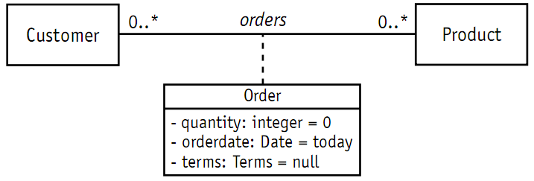
Association class Encapsulates information about an association.

Slide 5
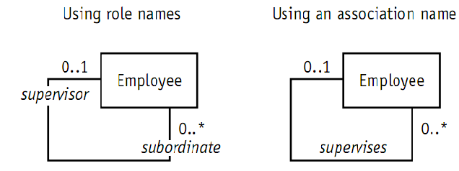
Reflexive association Reflexive association is a fancy expression that says objects in the same class can be related to one another. The entire association notation you’ve learned so far remains exactly the same, except that both ends of the association line point to the same class.

Slide 6
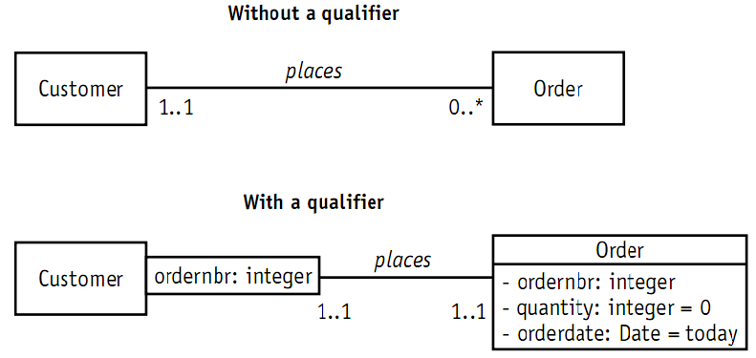
Qualified Association

Slide 7
Aggregation and Composition
Aggregation is a special type of association used to indicate that the participating objects are not just independent objects that know about each other. Instead, they are assembled or configured together to create a new, more complex object.
For example, a number of different parts are assembled to create a car, a boat, or a plane.
Composition is used for aggregations where the life span of the part depends on the life span of the aggregate.
The aggregate has control over the creation and destruction of the part. In other words, the member object cannot exist apart from the aggregation.

Slide 8
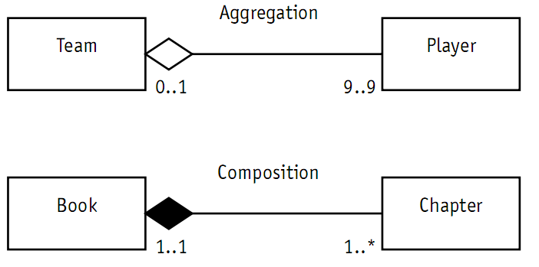
Aggregation and Composition > Players are assembled into a team. But if the Team is disbanded, the players live on (depending of course on how well they performed). > The Book example uses composition, the solid diamond. A Book is composed of Chapters. The Chapters would not continue to exist elsewhere on their own. They would cease to exist along with the Book.

Slide 9
Example
Problem statement:
Our Company maintains a group of race cars. Our cars use some of our new 8-cylinder engines and new transmissions. Once the engines are assembled, the pistons, carburetor, and plugs cannot be swapped between engines due to changes caused by the high temperatures.
“We want to keep records of the performance achieved by each engine in each car and each transmission in combination with each engine. Our drivers evaluate each car to give us their assessment of the handling. We need a system to track the configurations and the drivers’ assessments.”

Slide 10
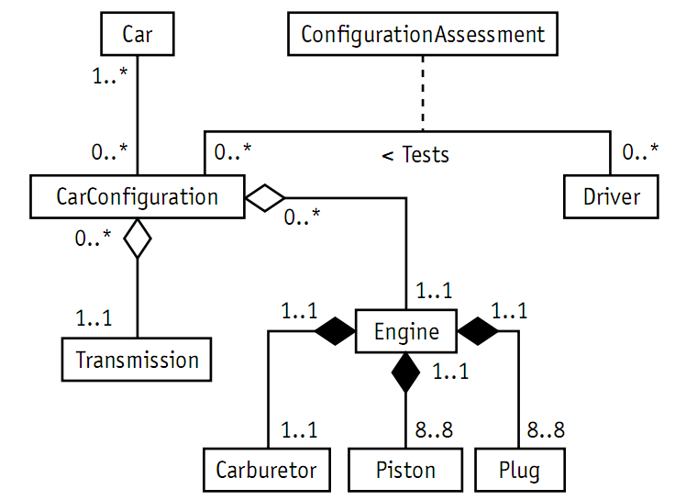
Sample Solution

Slide 11
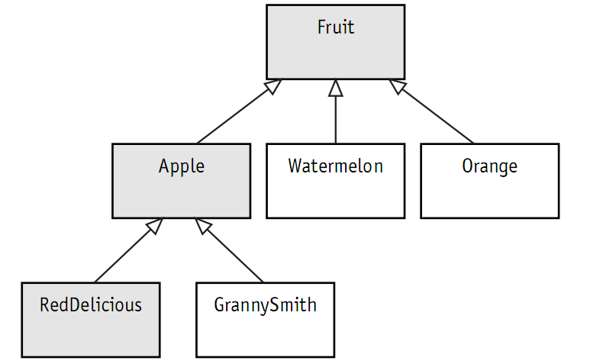
Generalization
Generalization is the process of organizing the properties of a set of objects that share the same purpose.
A generalization is not an association.

